Slide 1
Chapter 16
How to design an object-oriented program

Slide 2
Applied objectives
Design an object-oriented program and create a UML diagram for it.
Given the UML diagram for a program, develop the program with a three-tier architecture.

Slide 3
Knowledge objectives
Describe each of these steps for designing the model for an object-oriented program:
Identify the data attributes Subdivide each attribute into its smallest components Identify the classes Identify the methods Refine the classes, attributes, and methods
Describe the relationship between a class in an object-oriented program and an entity in the real world.
Distinguish between the presentation tier, the database tier, and the business tier in a three-tier architecture.

Slide 4
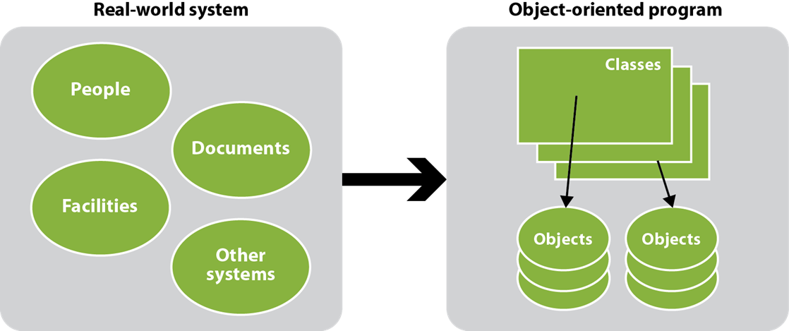
An object-oriented program is modeled after a real-world system

Slide 5
Five steps for designing an object-oriented program
Step 1: Identify the data attributes
Step 2: Subdivide each attribute into its smallest useful components
Step 3: Identify the classes
Step 4: Identify the methods
Step 5: Refine the classes, attributes, and methods

Slide 6
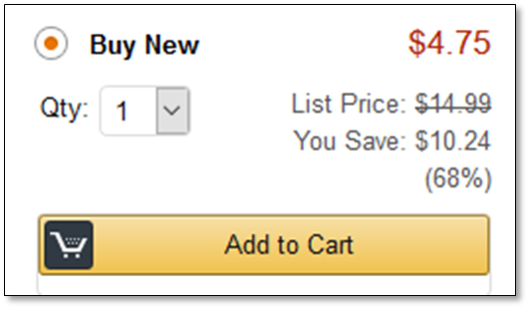
A screen capture that can be used to identify data attributes

Slide 7
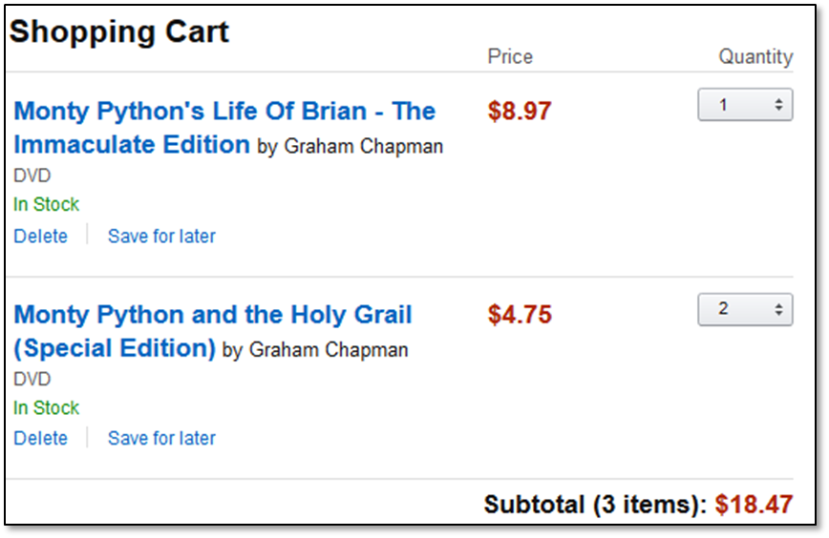
Another screen capture that can be used to identify data attributes

Slide 8
The data attributes identified from the screen captures
Product name List price Item count
Product creator Discount percent Cart total
Product format Discount amount Quantity
Stocking message Discount price

Slide 9
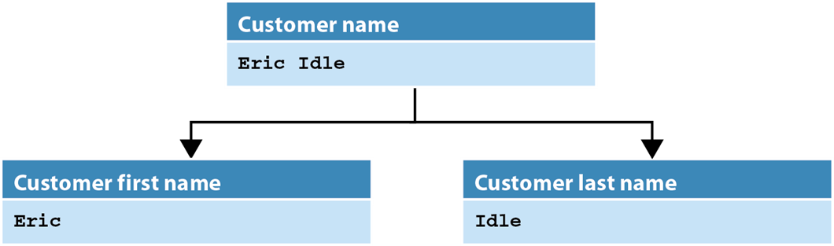
A customer name divided into first and last name

Slide 10
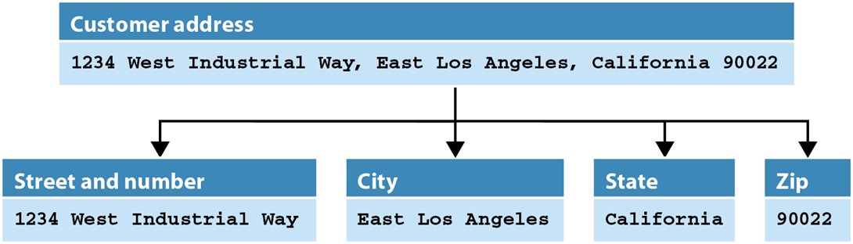
An address that’s divided into its components

Slide 11
Possible classes and attributes for a Shopping Cart program
Product LineItem Cart
Product name* Product name* Item count
Product edition Product discount price* Cart total
Product creator Quantity
Product format Line item total
Product stocking message
Product price
Product discount percent
Product discount amount
Product discount price*

Slide 12
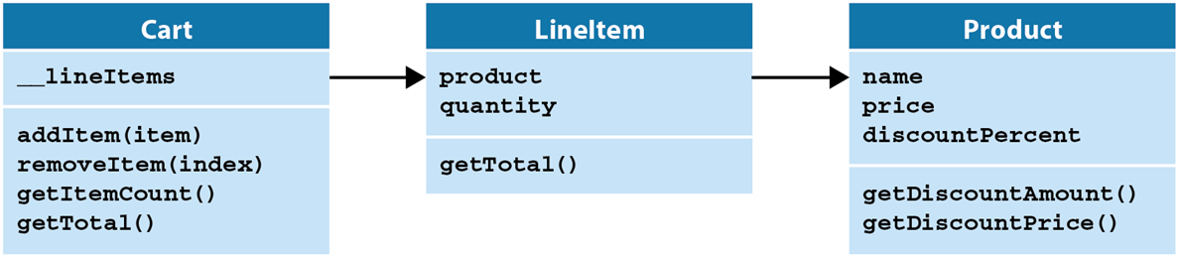
The UML diagram for the classes of the Shopping Cart program

Slide 13
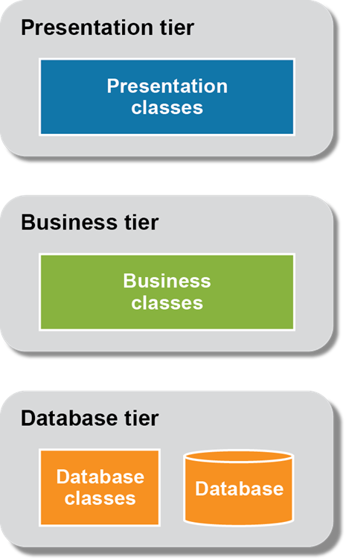
The three-tier architecture of an application

Slide 14
The business module (part 1)
class Product:
def __init__(self, name="", price=0.0, discountPercent=0):
self.name = name
self.price = price
self.discountPercent = discountPercent
def getDiscountAmount(self):
discountAmount = self.price * self.discountPercent / 100
return round(discountAmount, 2)
def getDiscountPrice(self):
discountPrice = self.price - self.getDiscountAmount()
return round(discountPrice, 2)
class LineItem:
def __init__(self, product=None, quantity=1):
self.product = product
self.quantity = quantity
def getTotal(self):
total = self.product.getDiscountPrice() * self.quantity
return total

Slide 15
The business module (part 2)
class Cart:
def __init__(self):
self.__lineItems = []
def addItem(self, item):
self.__lineItems.append(item)
def removeItem(self, index):
self.__lineItems.pop(index)
def getTotal(self):
total = 0.0
for item in self.__lineItems:
total += item.getTotal()
return total
def getItemCount(self):
return len(self.__lineItems)

Slide 16
The business module (part 3)
def __iter__(self):
self.__index = -1
return self
def __next__(self):
if self.__index == len(self.__lineItems)-1:
raise StopIteration
self.__index += 1
lineItem = self.__lineItems[self.__index]
return lineItem

Slide 17
The products.csv file
The Holy Grail (DVD),4.75,30
Life of Brian (DVD),8.97,20
The Meaning of Life (DVD),6.50,15

Slide 18
The db module
import csv
from business import Product
FILENAME = "products.csv"
def get_products():
products = []
with open(FILENAME, newline="") as file:
reader = csv.reader(file)
for row in reader:
# convert row to Product object
product = Product(row[0], float(row[1]), int(row[2]))
products.append(product)
return products

Slide 19
Code that tests the database and business layers
import db
from business import Product, LineItem, Cart
products = db.get_products()
product = products[1]
lineItem = LineItem(product, 2)
cart = Cart()
cart.addItem(lineItem)
print("Product: ", product.name)
print("Price: ", product.getDiscountPrice())
print("Quantity: ", lineItem.quantity)
print("Total: ", cart.getTotal())
The console
Product: Life of Brian (DVD)
Price: 7.18
Quantity: 2
Total: 14.36

Slide 20
The user interface (part 1)
The Shopping Cart program
COMMAND MENU
cart - Show the cart
add - Add an item to the cart
del - Delete an item from cart
exit - Exit program
PRODUCTS
Item Name Price Discount Your Price
1 The Holy Grail (DVD) 4.75 30% 3.32
2 Life of Brian (DVD) 8.97 20% 7.18
3 The Meaning of Life (DVD) 6.50 15% 5.53
Command: add
Item number: 1
Quantity: 2
Item 1 was added.
Command: add
Item number: 3
Quantity: 1
Item 2 was added.

Slide 21
The user interface (part 2)
Command: cart
Item Name Your Price Quantity Total
1 The Holy Grail (DVD) 3.32 2 6.64
2 The Meaning of Life (DVD) 5.53 1 5.53
12.17
Command: del
Item number: 1
Item 1 was deleted.
Command: cart
Item Name Your Price Quantity Total
1 The Meaning of Life (DVD) 5.53 1 5.53
5.53
Command: exit
Bye!

Slide 22
The shopping_cart module (part 1)
import db
from business import Product, LineItem, Cart
def show_title():
print("The Shopping Cart program")
print()
def show_menu():
print("COMMAND MENU")
print("cart - Show the cart")
print("add - Add an item to the cart")
print("del - Delete an item from cart")
print("exit - Exit program")
print()

Slide 23
The shopping_cart module (part 2)
def show_products(products):
print("PRODUCTS")
line_format1 = "{:<5s} {:<25s} {:>10s} {:>10s} {:>12s}"
line_format2 = "{:<5d} {:<25s} {:>10.2f} {:>10s} {:>12.2f}"
print(line_format1.format("Item", "Name", "Price",
"Discount", "Your Price"))
for i in range(len(products)):
product = products[i]
print(line_format2.format(i+1,
product.name,
product.price,
str(product.discountPercent) + "%",
product.getDiscountPrice()))
print()

Slide 24
The shopping_cart module (part 3)
def show_cart(cart):
if cart.getItemCount() == 0:
print("There are no items in your cart.\n")
else:
# items = cart.lineItems
line1 = "{:<5s} {:<25s} {:>12s} {:>10s} {:>10s}"
line2 = "{:<5d} {:<25s} {:>12.2f} {:>10d} {:>10.2f}"
print(line1.format("Item", "Name", "Your Price",
"Quantity", "Total"))
i = 0
for item in cart:
print(line2.format(i+1,
item.product.name,
item.product.getDiscountPrice(),
item.quantity,
item.getTotal()))
i += 1
print("{:>66.2f}".format(cart.getTotal()))
print()

Slide 25
The shopping_cart module (part 4)
def add_item(cart, products):
number = int(input("Item number: "))
quantity = int(input("Quantity: "))
if number < 1 or number > len(products):
print("No product has that number.\n")
else:
# Get Product object, store in LineItem object,
# and add to Cart object
product = products[number-1]
item = LineItem(product, quantity)
cart.addItem(item)
print("Item " + str(cart.getItemCount()) +
" was added.\n")
def remove_item(cart):
number = int(input("Item number: "))
if number < 1 or number > cart.getItemCount():
print("The cart does not contain an item " +
"with that number.\n")
else:
# Remove LineItem object at specified index from cart
cart.removeItem(number-1)
print("Item " + str(number) + " was deleted.\n")

Slide 26
The shopping_cart module (part 5)
def main():
show_title()
show_menu()
# get a list of Product objects and display them
products = db.get_products()
show_products(products)
# create a Cart object to store LineItem objects
cart = Cart()
while True:
command = input("Command: ")
if command == "cart":
show_cart(cart)
elif command == "add":
add_item(cart, products)
elif command == "del":
remove_item(cart)
elif command == "exit":
print("Bye!")
break
else:
print("Not a valid command. Please try again.\n")

Slide 27
The shopping_cart module (part 6)
if __name__ == "__main__":
main()

